Slide 1

Ocean of Learning (Coding and Learning website)
(GROUP 14)
BY
Yash Dixit
(Roll no. 1803310245)
&
Sachin Kushwaha
(ROLL NO. 1803310175)
Guided By:
Manish Gupta
&
Neetu Bansla
RAJ KUMAR GOEL INSTITUTE OF TECHNOLGY
Dr. A. P. J. Abdul Kalam Technical University, Lucknow

Slide 2
Ocean of Learning is an online platform where you can learn competitive programming, latest technologies and at the same time challenge others with your own questions. It is a not-for-profit educational initiative. It is a global programming community that fosters learning and friendly competition, built on top of the world’s largest competitive programming platform. Ocean of Learning was created as a platform to help programmers make it big in the world of algorithms and computer programming. Today there are dozens of websites available that not only hosts high level competitive contests but also are hub to some of the most challenging programming questions. Sometimes it become difficult to understand which website to choose for competition purpose and are they providing us the same level of competitive questions that are asked by dream companies like Google, Microsoft, Amazon etc. Thus in Ocean of Learning we provide a collection of every such question that is previously asked in dream companies along with the best questions from every such website available till date. Thus no need to wander anymore just join Ocean of Learning and start learning coding for real.
ABSTRACT

Slide 3
LITERATURE REVIEW
RESEARCH PAPER 1:
A QUALITATIVE STUDY OF MAJOR PROGRAMMING LANGUAGES: TEACHING PROGRAMMING LANGUAGES TO COMPUTER SCIENCE STUDENTS
https://www.researchgate.net/publication/306438454_A_qualitative_study_of_major_programming_languages_teaching_programming_languages_to_computer_science_students
RESEARCH PAPER 2:
Learning Styles in the e-Learning Environment: The Approaches and Research on Longitudinal Changes
https://www.researchgate.net/publication/313472672_Learning_Styles_in_the_e-Learning_Environment_The_Approaches_and_Research_on_Longitudinal_Changes

Slide 4
An online platform to practice competitive programming, Learn latest technologies and at the same time challenge others with your own mini contests to promote better learning and understanding.
PROBLEM STATEMENT

Slide 5
HARDWARE REQUIREMENTS:
OBJECTIVE
The objective behind creating such website is to promote competitive programming . At times it become difficult to understand which website to choose for competition purpose and are they providing us the same level of competitive questions that are asked by dream companies like Google, Microsoft, Amazon etc.
Thus in Ocean of Learning we provide a collection of every such question that is previously asked in dream companies , along with the best questions from every such website available till date.
We not only help in developing coding skills but also helps in providing effective knowledge about latest technologies and programming languages.
Choose the language you want to learn select some technology click on links referring to the course and there you go.
Apart from that we also promote learning with fun concept as users can create there own mini contests, challenge there friends with there own questions and compete against each other.
Thus no need to wander anymore just join Ocean of Learning and start learning coding for real.

Slide 6
HARDWARE REQUIREMENTS:
METHODOLOGY
Ocean of Learning is a not-for-profit educational initiative. It is a global programming community that fosters learning and friendly competition, built on top of the world’s largest competitive programming platform . Ocean of Learning was created as a platform to help programmers make it big in the world of algorithms and computer programming.
OCEAN OF LEARNING IS BASICALLY DIVIDED INTO THE FOLLOWING 3 SECTIONS:
Programming: Our programming section is the top highlight of our website. We in Ocean of Learning not only provides every challenging question asked by dream companies like Google, Microsoft, Amazon etc. but also top questions from websites like Hakerank , Codechef etc if approved by there authors.
Courses: Courses is another highlight of our website. We not only help in developing coding skills but also helps in providing effective knowledge about latest technologies and programming languages. Choose the language you want to learn select some technology click on links referring to the course and there you go.
Editor: Editor is a special section of our website. After you learn some language and technology, practiced some questions on it, now its your time to contribute. Under editor section you can post your own programming questions. These questions may be previously asked or picked up from some website.

Slide 7
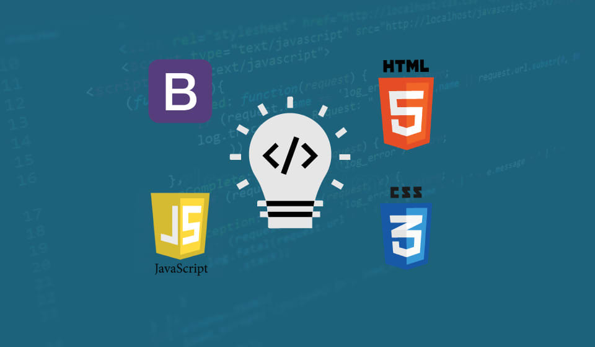


DESIGN
DATABASE:
SQLITE
FRONT END: HTML, CSS, JAVA SCRIPT, BOOTSTRAP
BACKEND: DJANGO

Slide 8
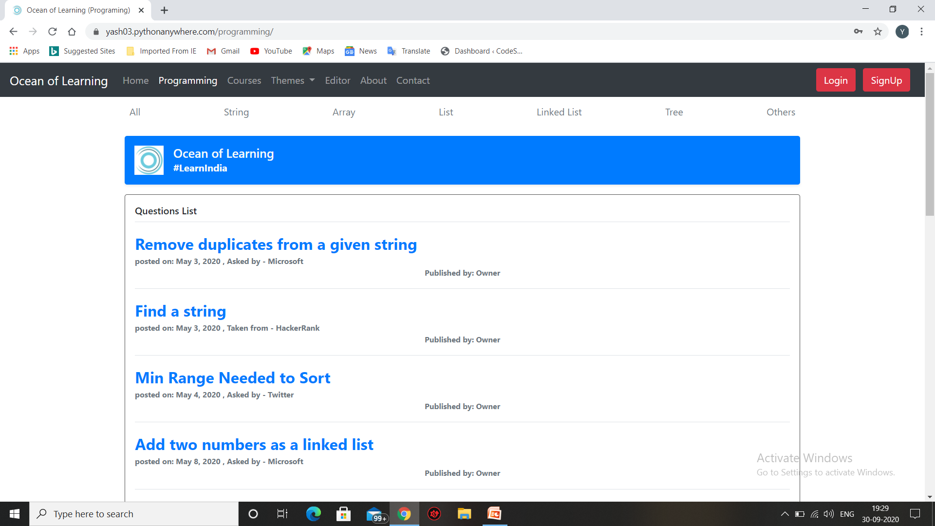
HARDWARE REQUIREMENTS:
SNAPSHOT -1

Slide 9
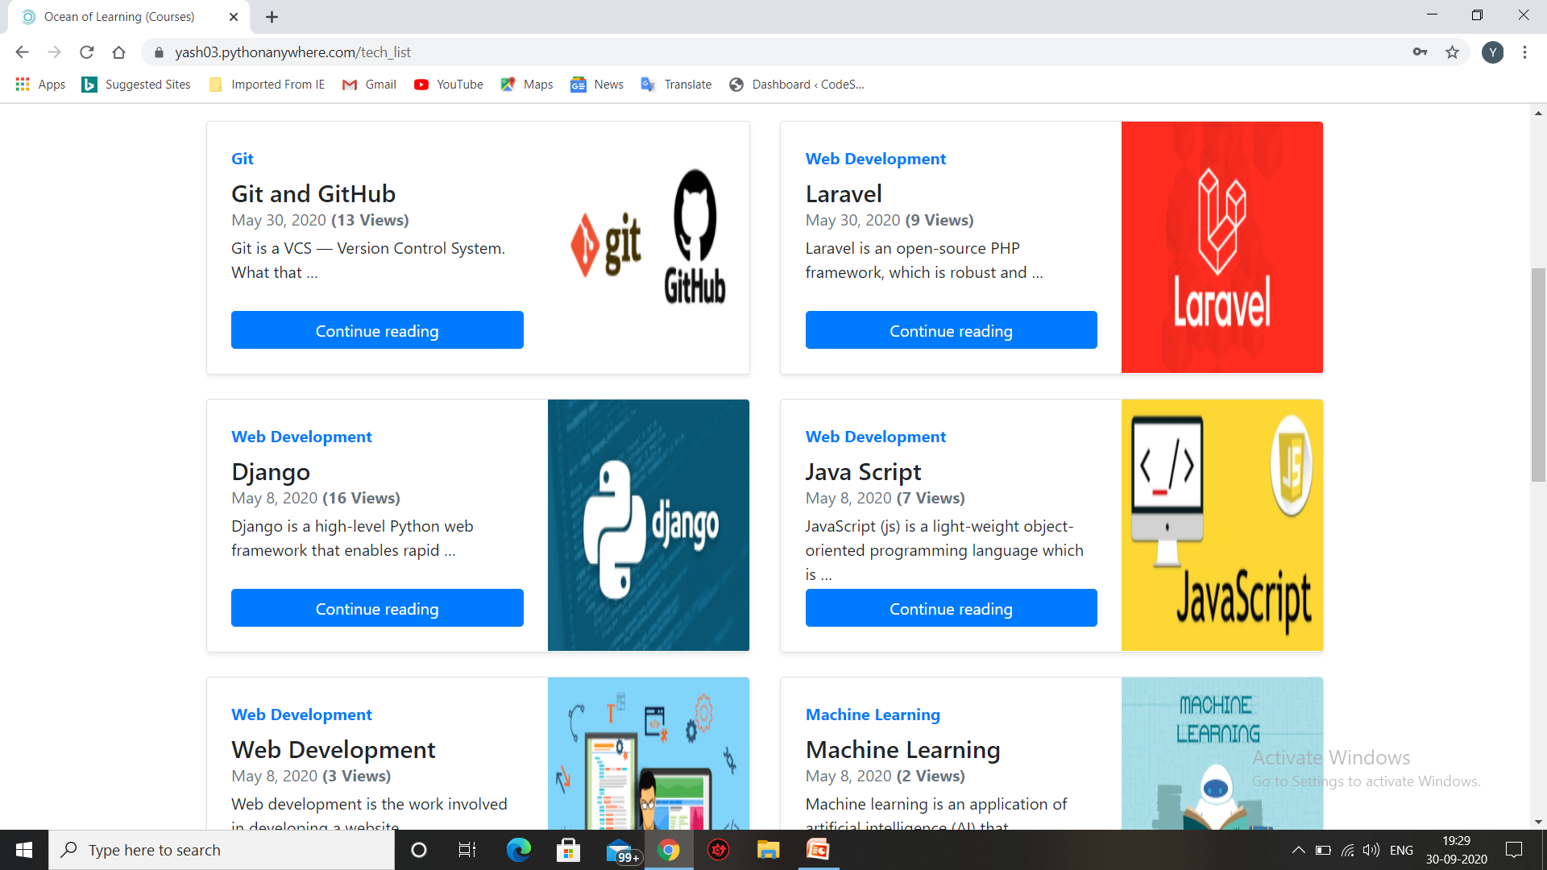
HARDWARE REQUIREMENTS:
SNAPSHOT -2

Slide 10
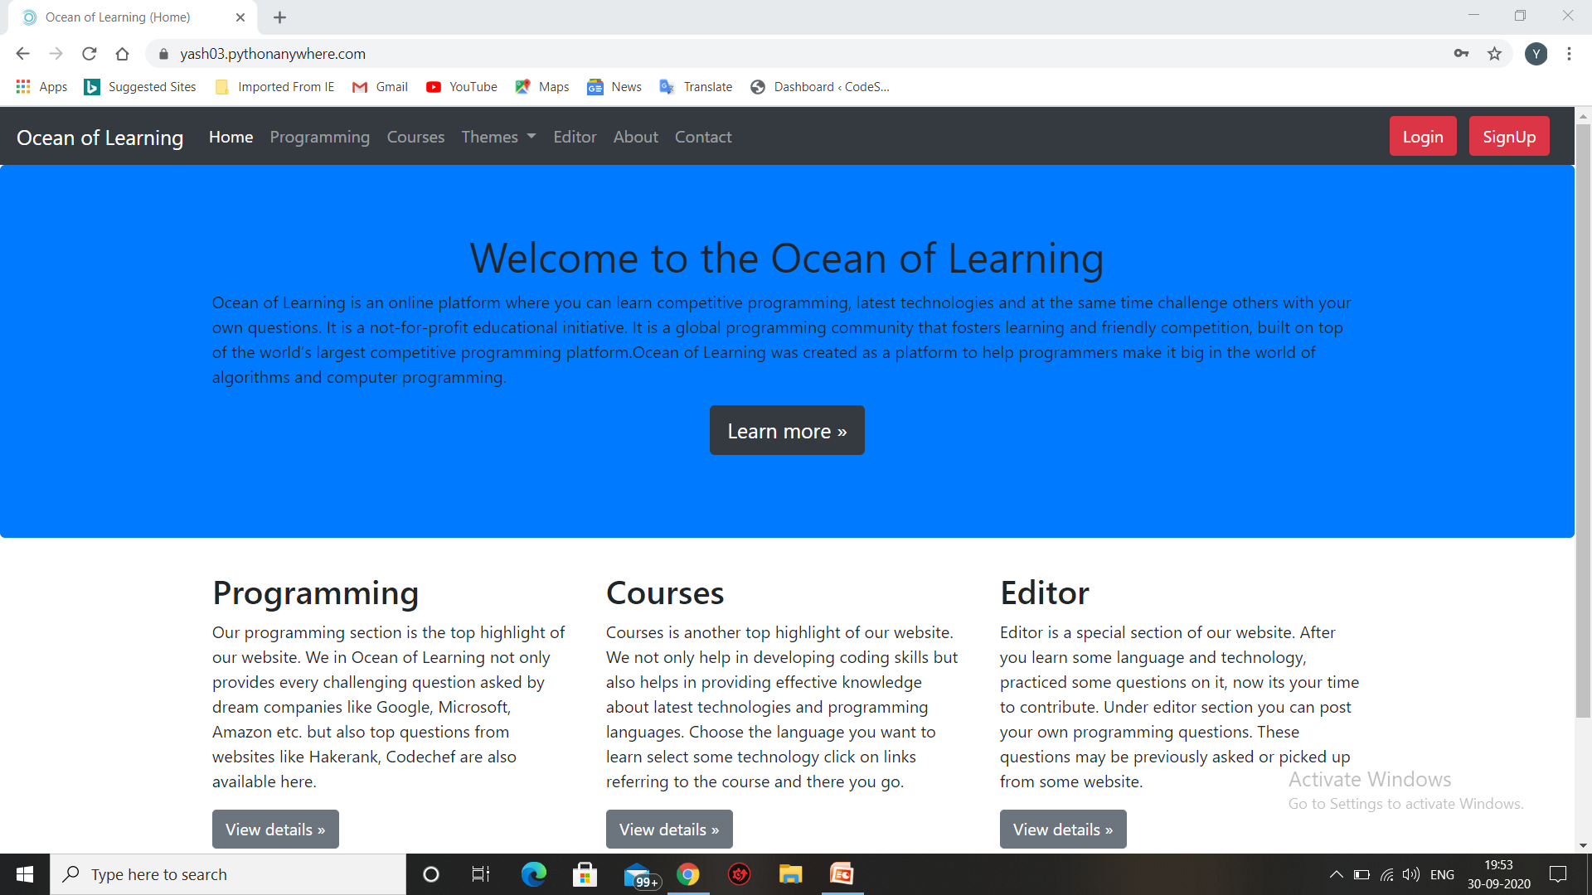
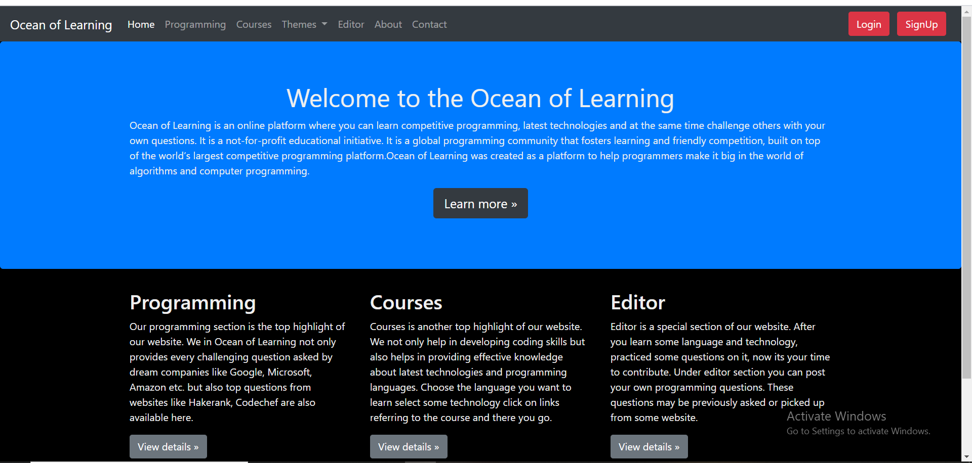
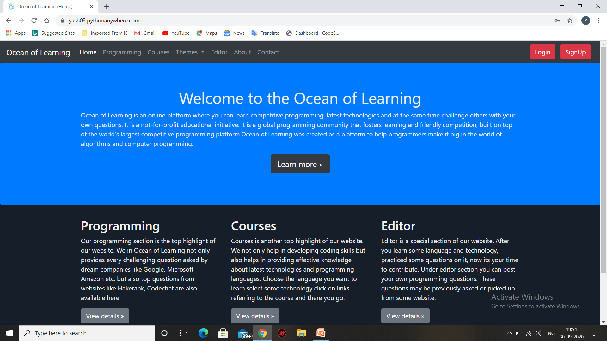
HARDWARE REQUIREMENTS:
MODES OR THEMES
LIGHT THEME
DARK THEME
DIM DARK THEME

Slide 11
HARDWARE REQUIREMENTS:
IMPLEMENTATION STATUS
In spite of having many hardships and difficulties on our way we have successfully prepared our website. All thanks to our mentors to provide us ample of support and encouragement.
Ocean of Learning is successfully developed within the given time and has been temporarily hosted on pythonanywhere.com’s server.
Currently our website is in testing phase. We are trying to divert as many audience as possible on our website to check for any possible issues.
Till now we haven’t encountered any issues and haven’t received any complains from any user. At times we take maintenance break to improve the design and animation of our website but rest everything seems fine.
Our Website Link: https://yash03.pythonanywhere.com/

Slide 12
HARDWARE REQUIREMENTS:
RESEARCH PAPER STATUS
It took us some time to collect enough resource to prepare a research paper as our idea is quiet different. Instead of focusing on e-learning or coding alone it focuses on the need and importance of an environment where people can learn systematic coding content and practice their skills to make big in this technical world.
We have read many research paper on importance of coding and advantages of e-learning etc and finally after combining our objective and their guidance we have gathered enough data to write a quality technical paper that suits our motto.
Implementation is already started and everything is going smoothly. We should be able to provide quality content soon.

Slide 13

1. MORE COURSES WILL BE ADDED. 2. WE WILL TRY TO OPEN COURSES section SO THAT ANY RANDOM PERSON CAN UPLOAD AND PROMOTE THEIR OWN CONTENT AND THAT TO FREE OF COST. 3. INORDER TO INCREASE EFFICIENCY OF THE WEBSITE WE WILL TRY TO SHIFT OUR FRONTEND TO REACT FRAMEWORK.
FUTURE WORK

Slide 14

ANY QUERY
THANK YOU

